Slide 1

Robust Lung Cancer Prediction: Handling Incomplete and Noisy Clinical Data Using Deep Learning
FYP Proposal Defense
03-134231-005 | Abdullah Asim
03-134222-035. | Hussnain Khalid

Slide 2
CLO Mapping
CLO | PLO | Description | Specified Aspects
CLO1 | PLO3:Problem Analysis | Analyze lung cancer detection gaps to propose DL solutions
CLO2 | PLO4:Design and Development of Solutions | Design U-Net and CNN-RNN hybrid computing solutions
CLO3 | PLO5:Modern Tool Usage | Use Flutter, FastAPI, and PyTorch for development
CLO4 | PLO6:Individual and Team Work | Demonstrate effective teamwork between two members
CLO5 | PLO10:Life Long Learning | Understand legal/clinical implications of AI in healthcare
CLO6 | PLO7:Communication | Present technical findings through reports and defense

Slide 3
Abstract
Lung cancer is a leading cause of global mortality
Radiologists face fatigue from interpreting 3D CT scan stacks
Current AI systems lack transparency "Black Boxes“
Proposed system uses slice-level analysis for higher precision
Visual "Confidence Aware" markers (Red/Yellow/Green) guide clinicians
Spatio-temporal modeling predicts future tumor development regions

Slide 4
Objectives
To develop a segmentation-based DL model using Residual U-Net
To implement "Slice-Level Risk Trend" analysis for small lesions
To design a "Confidence Aware" visual display with heat maps
To incorporate multi-level interpretability (Global and Pixel-level)
To predict the "Next Likely Development Region" using AI
To create a responsive Flutter desktop dashboard for radiologists
Novelty:
Moves beyond static "Yes/No" detection into interpretable forecasting
Examines every individual scan layer instead of broad verdicts
Introduces the "Next Likely Development Region" for growth timing
Combines local pixel-level explanations with global risk trends

Slide 5
Deliverable and Beneficiaries
Following are the deliverables
  Radiologist Decision Support Dashboard (Desktop App)
  Python-based AI Engine (FastAPI)
  Spatio-Temporal Forecasting Module
Following are the beneficiaries
  Radiologists
  Patients
  Hospitals

Slide 6
Scope
PRIMARY
  Automatic lung nodule detection using Deep Learning
  Heat maps (Grad-CAM) showing AI focus areas
  Interactive desktop application for DICOM/NIFTI file viewing
OPTIONAL
  Server-side processing for heavy AI computations
  Local database synchronization via Firebase

Slide 7
Methodology
Primary Dataset: Data is sourced from Kaggle (specifically the Lung Image Database Consortium / LIDC-IDRI or similar lung cancer datasets).
Data Format: Supports DICOM and NIfTI medical imaging standards for high-resolution 3D analysis.
Addressing Imbalance: Most scans in collections are often healthy; the methodology uses Data Augmentation (rotation, brightness, and shape twisting) to weight cancer cases effectively.
Normalization: Implementation of HU (Hounsfield Unit) Normalization and resampling to ensure consistency across different CT scanners

Slide 8
Methodology [2/2]
Nodule Segmentation: Employs a Residual U-Net architecture for high-precision boundary detection of lung nodules.
Risk Stratification: A CNN-RNN hybrid model analyzes the segmented regions to calculate malignancy probabilities.
Spatio-Temporal Modeling: Watches how tissue "bends and stretches" to predict the "Next Likely Development Region".
Multi-Level Interpretability: Uses Grad-CAM heatmaps to highlight specific pixels that influenced the AI’s decision

Slide 9
Methodology [3/4]
Client-Server Design: Splits the system into a lightweight frontend and a powerful server-side backend.
Backend Processing: Python FastAPI handles heavy computations and AI logic quietly behind the scenes.
Database Integration: Firebase manages real-time updates for patient logs, metadata, and cloud storage of scans.
Communication: Utilizes a REST API with a shared JSON structure to ensure smooth data exchange between Dart (Flutter) and Python.

Slide 10
Methodology [4/4]
Interactive Dashboard: Built with Flutter for a responsive desktop experience that adjusts to any window size.
Confidence Indicators: A color-coded system guides the radiologist without needing words:
Red (Score > 70%): High Danger/Malignant.
Yellow (30% - 70%): Uncertain/Physician review recommended.
Green (Score < 30%): Benign/Clear area.
Slice-Level Analysis: Replaces a single "yes/no" verdict with a detailed risk analysis for every individual scan layer.

Slide 11
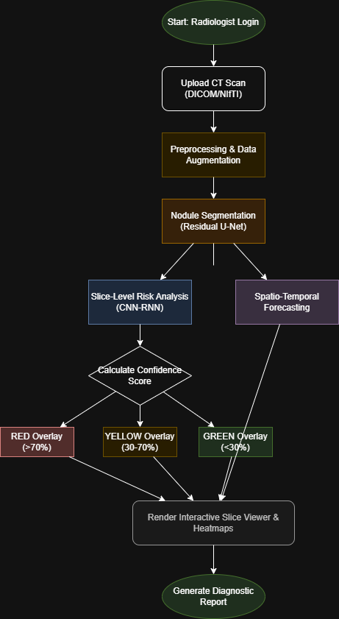
Flow Chart

Slide 12
Resources and Risks
Hardware: High-performance laptops ($1,350)
Cloud: Google Colab Pro for model training
Team: Proficiency in Python, Flutter, and DL
Budget: Rs. $1,475 (~PKR 413,000)
Risks
Data Imbalance: Mitigated by angle/brightness augmentation
Hardware Strain: Mitigated by sequential image processing
Integration: Speaking through shared JSON structures (REST API)

Slide 13
Gantt Chart [7th Semester]
1st Gantt Chart Figure from your proposal
Task / Activity | Month 1-2 | Month 3-4 | Month 5-6
1. Model Design & Architecture (Selecting algorithms, designing database schema, and planning the API) | ██
2. AI Implementation (Backend) (Data preprocessing, training U-Net/CNN models in Python) |  | ██
3. Flutter Design (Frontend) (Designing App screens, UI/UX, and Slice Viewer layout) |  |  | ██

Slide 14
Gantt Chart [8th Semester]
2nd Gantt Chart Figure from your proposal
Task / Activity | Month 7-8 | Month 9-10 | Month 11-12
4. System Integration (Connecting Flutter App with Python Backend via API) | ██
5. Testing & Forecasting Module (Validating accuracy and adding the "Growth Prediction" feature) |  | ██
6. Final Report & Documentation (Writing thesis, creating user manuals, and preparing for defence) |  |  | ██

Slide 15
Robust Lung Cancer Prediction: Handling Incomplete and Noisy Clinical Data Using Deep Learning
Thanks
Please feel free to:
  Ask any further details
  Advise any improvements
FYP Proposal Defense
03-134231-005 | Abdullah Asim
03-134222-035. | Hussnain Khalid

